Slide 1
Mapping Teamcenter attributes to SolidWorks drawing title blocks
The setup involves the following steps:
Modify an existing drawing template’s sheet format to include notes which reference drawing model parameters
Save the modfied sheet format to the standard formats directory location
When creating a new drawing, select the custom sheet format
Map the drawing model parameters to corresponding Teamcenter attributes, in the pdmtocad direction

Slide 2
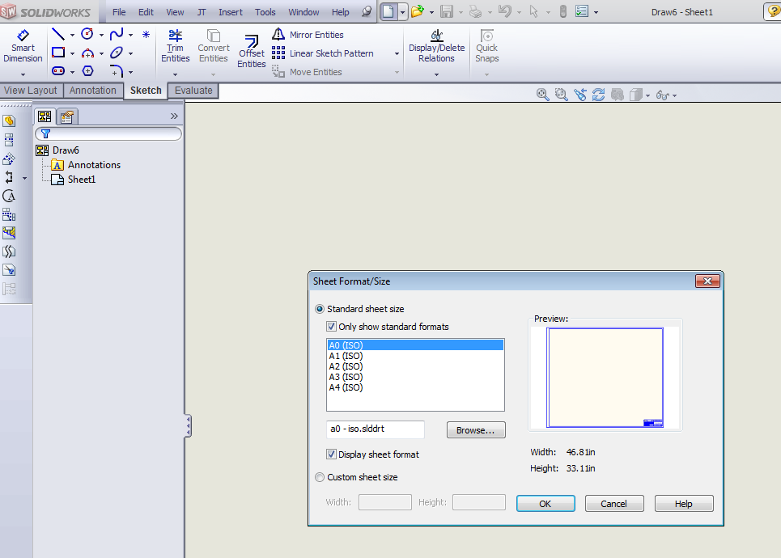
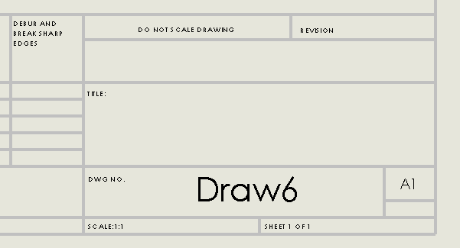
Mapping Teamcenter attributes to SolidWorks drawing title blocks
Step 1: Modify an existing drawing template’s sheet format to include notes which reference drawing model parameters
Create a new drawing using an existing format whose title block already contains PDM-like cells – the A0 ISO format is a good choice:

Slide 3
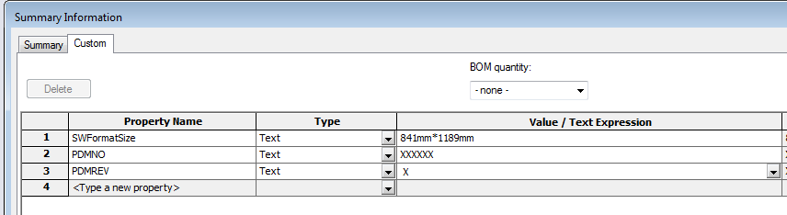
Mapping Teamcenter attributes to SolidWorks drawing title blocks
Add model parameters to the new drawing – these will be mapped from Teamcenter later. You may want to assign placeholder values to the parameters:

Slide 4
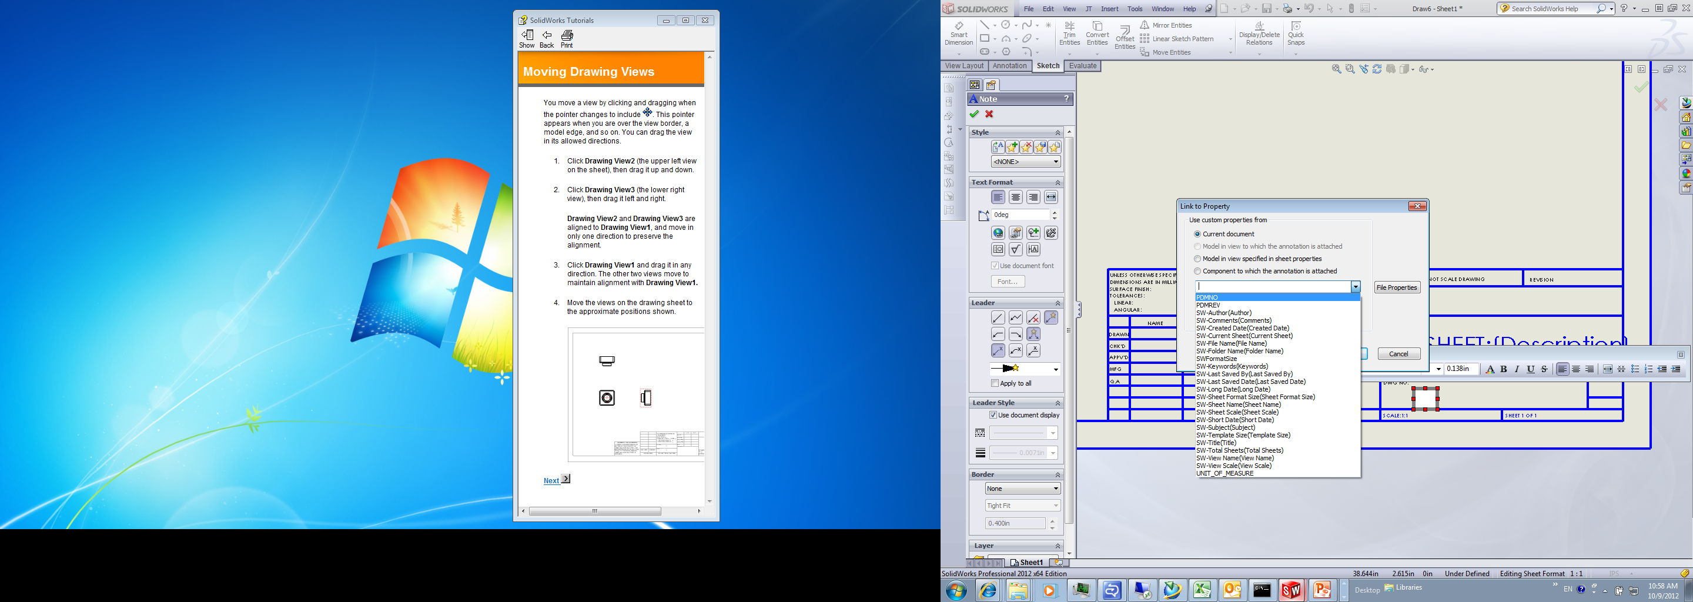
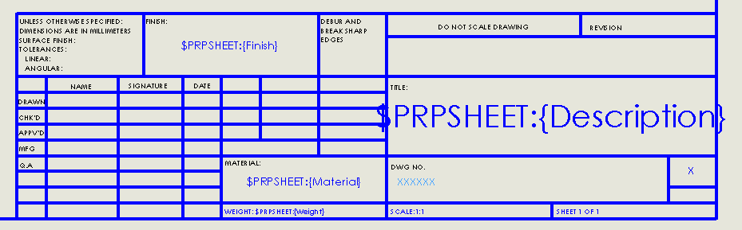
Mapping Teamcenter attributes to SolidWorks drawing title blocks
Edit the sheet format of the drawing, then add notes which reference the values of the model parameters, in the appropriate place in the drawing title block:
Be sure the make the font small enough, and position the note so that the Teamcenter-mapped values will fit

Slide 5
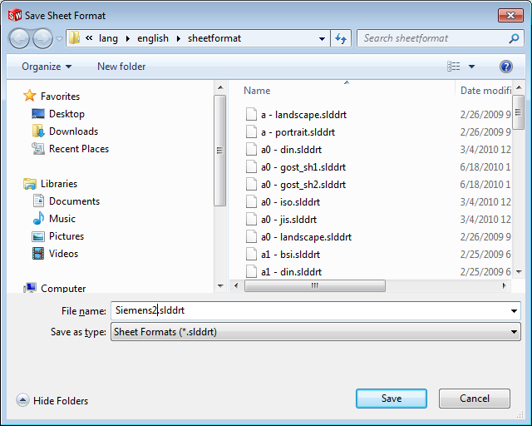
Mapping Teamcenter attributes to SolidWorks drawing title blocks
Step 2: Save the modfied sheet format to the standard formats directory location
Select File->Save Sheet Format, then save the file to the standard formats directory with a new name

Slide 6
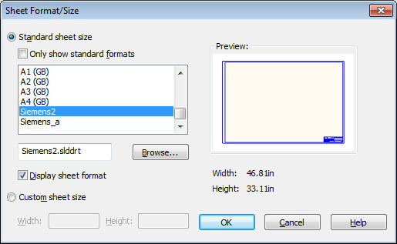
Mapping Teamcenter attributes to SolidWorks drawing title blocks
Step 3: When creating a new drawing, select the custom sheet format

Slide 7
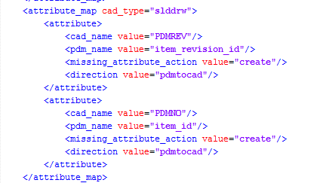
Mapping Teamcenter attributes to SolidWorks drawing title blocks
Step 4: Map the drawing model parameters to corresponding Teamcenter attributes, in the pdmtocad direction

Slide 8
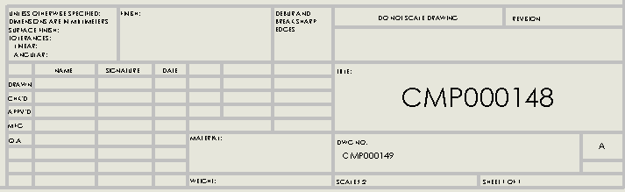
Mapping Teamcenter attributes to SolidWorks drawing title blocks
While saving the new drawing to Teamcenter, the title block notes will be populated with the values assigned by Teamcenter. When opening the drawing from Teamcenter, the notes will be updated to match what has changed in Teamcenter:

